Slide 1
C# OOPS

Slide 2
Mr. M.R. Solanki
Sr. Lecturer, Information Technology,
manish_ratilal2002@yahoo.com
SBMP

Slide 3
Learning Outcomes
Students will be able to:
Use access specifiers
Implement Inheritance

Slide 4
Inheritance

Slide 5

Types of Inheritance
Single Inheritance: In single inheritance, subclasses inherit the features of one superclass. In image below, the class A serves as a base class for the derived class B.

Slide 6
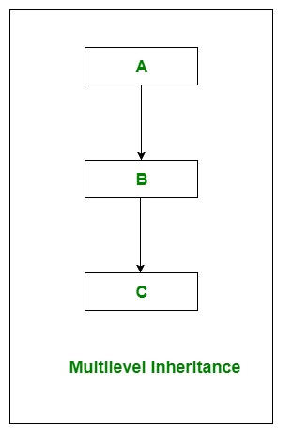
Types of Inheritance
Multilevel Inheritance: In Multilevel Inheritance, a derived class will be inheriting a base class and as well as the derived class also act as the base class to other class.

Slide 7
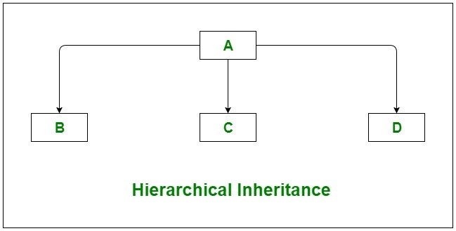
Types of Inheritance
Hierarchical Inheritance: In Hierarchical Inheritance, one class serves as a superclass (base class) for more than one subclass.

Slide 8

Types of Inheritance
Multiple Inheritance:In Multiple inheritance, one class can have more than one superclass and inherit features from all parent classes.
C# does not support multiple inheritance with classes. In C#, we can achieve multiple inheritance only through Interfaces. In the image below, Class C is derived from interface A and B.

Slide 9

Types of Inheritance
Hybrid Inheritance : It is a mix of two or more of the above types of inheritance. In C#, we can achieve hybrid inheritance only through Interfaces.

Slide 10
Inheritance Syntax
class derived-class : base-class
{
// methods and fields
.
.
}

Slide 11
Every class is implicitly a subclass of Object class.
A superclass can have any number of subclasses. But a subclass can have only one superclass.
Constructors are not members, so they are not inherited by subclasses, but the constructor of the superclass can be invoked from the subclass.

Slide 12
Passing parameter to base class constructor
Passing parameters from derived class to base class
public Student(type p1, type p2,…):base(p1)
{
rollNo = r;
}
Considering Person as base class (having name and age as instance members) and Student as derived class:
public Student(string n, int r):base(n)
{
rollNo = r;
}

Slide 13
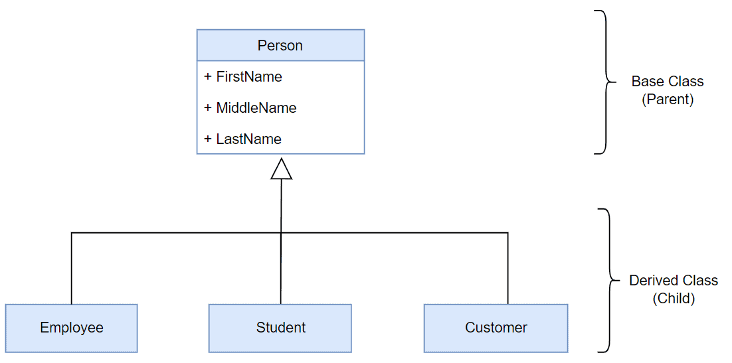

Slide 14
C# Access Specifiers

Slide 15
Access Modifiers
 | public | protected | Internal (default) | protected internal | private | private protected
Entire program | Yes | No | No | No | No | No
Containing class | Yes | Yes | Yes | Yes | Yes | Yes
Current assembly | Yes | No | Yes | Yes | No | No
Derived types within current assembly | Yes | Yes | Yes | Yes | No | Yes
Derived types within different assembly | Yes | Yes | No | Yes | No | No

Slide 16
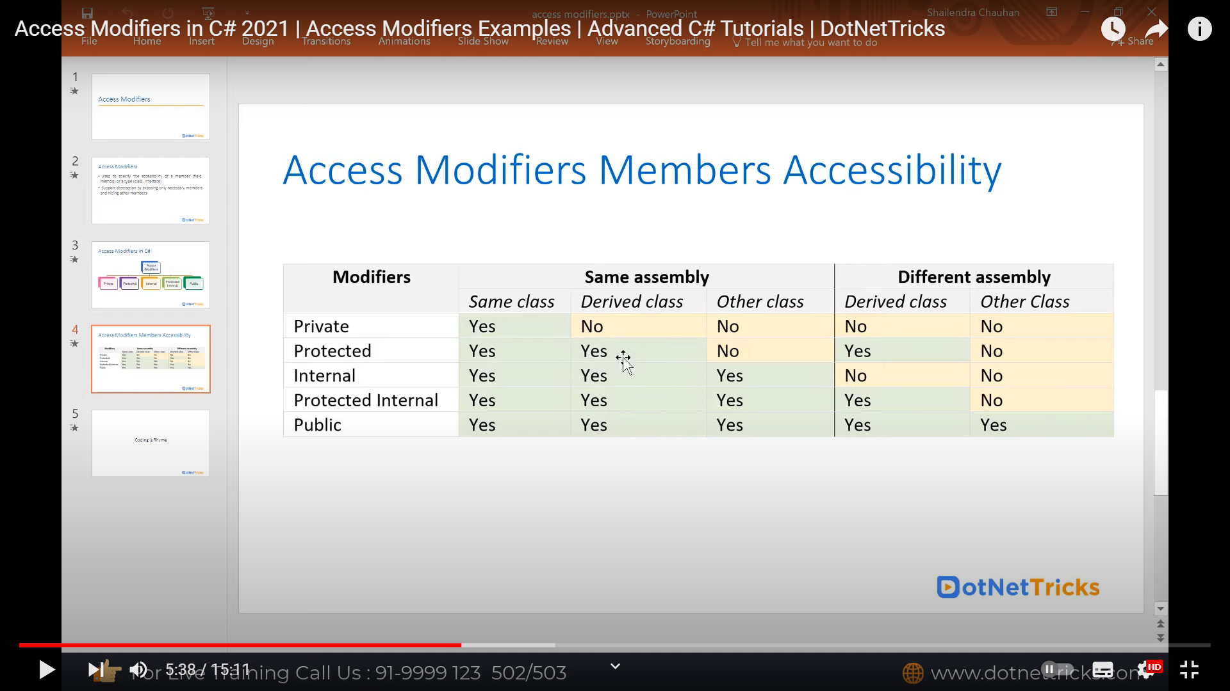
Access Modifiers
https://www.youtube.com/watch?v=sqcu19v7RcM&ab_channel=ScholarHatByDotNetTricks

Slide 17
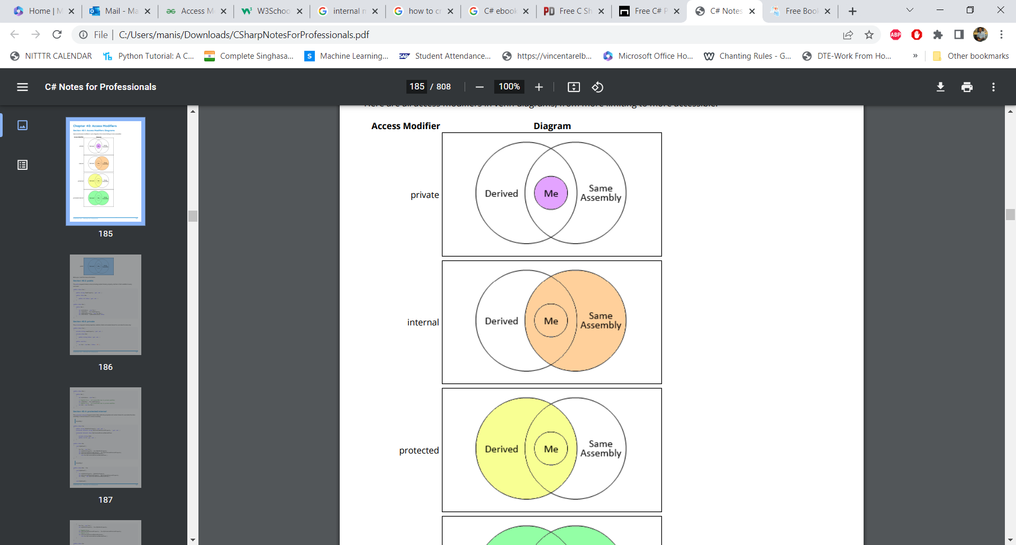

Slide 18
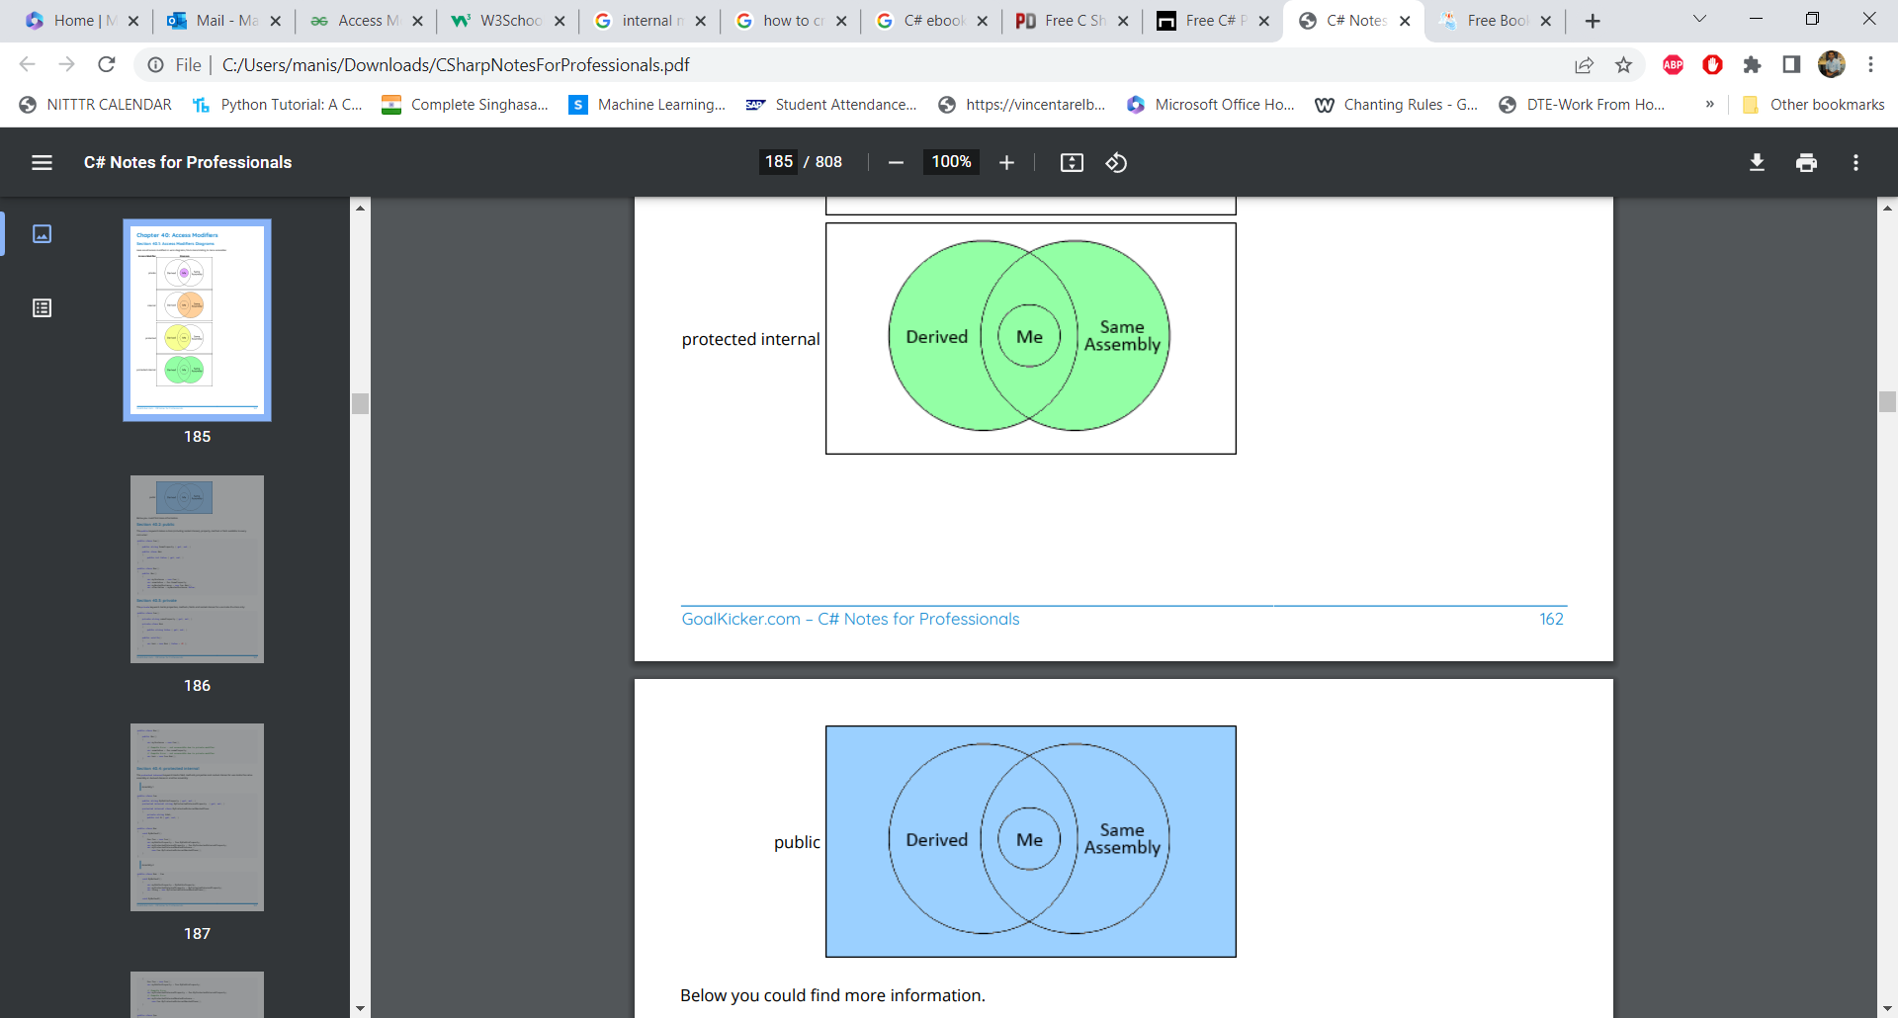
C# notes for professionals

Slide 19
protected can be accessed by derived class anywhere.
protected internal can be accessed by Same Assembly + derived class of another assembly

Slide 20
Classes are internal by default.
Members are private by default.

Slide 21
public example
using System;
namespace publicAccessModifier {
class Student {
// Declaring members rollNo
// and name as public
public int rollNo;
public string name;
// Constructor
public Student(int r, string n)
{
rollNo = r;
name = n;
}
// methods getRollNo and getName
// also declared as public
public int getRollNo()
{
return rollNo;
}
public string getName()
{
return name;
}
}

Slide 22
public example
Roll number: 2
Name: John
Roll number: 2
Name: John
class Program {
// Main Method
static void Main(string[] args)
{
// Creating object of the class Student
Student S = new Student(2, “John");
// Displaying details directly
// using the class members
Console.WriteLine("Roll number: {0}", S.rollNo);
Console.WriteLine("Name: {0}", S.name);
Console.WriteLine();
// Displaying details using member method
Console.WriteLine("Roll number: {0}", S.getRollNo());
Console.WriteLine("Name: {0}", S.getName());
} // end of Main
} // end of class
} // end of namespace

Slide 23
protected example
// C# Program to show the use of protected Access Modifier
using System;
namespace publicAccessModifier {
class Person{
protected string name;
protected Person(string n)
{
name=n;
}
}
class Student:Person {
// Declaring members rollNo
// and name as public
public int rollNo;
// Constructor
public Student(string n, int r):base(n)
{
rollNo = r;
}

Slide 24
protected example
// methods getRollNo and getName declared as public
public int getRollNo()
{
return rollNo;
}
public string getName()
{
return name;
}
}
class Program {
// Main Method
static void Main(string[] args)
{
// Creating object of the class Student
Student S = new Student("John",2);
Console.WriteLine();
// Displaying details using
// member method also public
Console.WriteLine("Roll number: {0}", S.getRollNo());
Console.WriteLine("Name: {0}", S.getName());
}
}}
Roll number: 2
Name: John

Slide 25
internal example
// C# Program to show use of
// internal access modifier
// Inside the file Program.cs
using System;
namespace internalAccessModifier {
// Declare class Complex as internal
internal class Complex {
int real;
int img;
internal void setData(int r, int i)
{
real = r;
img = i;
}
internal void displayData()
{
Console.WriteLine("Real = {0}", real);
Console.WriteLine("Imaginary = {0}", img);
}
}

Slide 26
internal example
// Driver Class
class Program {
// Main Method
static void Main(string[] args)
{
// Instantiate the class Complex
// in separate class but within
// the same assembly
Complex c = new Complex();
// Accessible in class Program
c.setData(2, 1);
c.displayData();
}
}
}

Slide 27
Adding another namespace

Slide 28
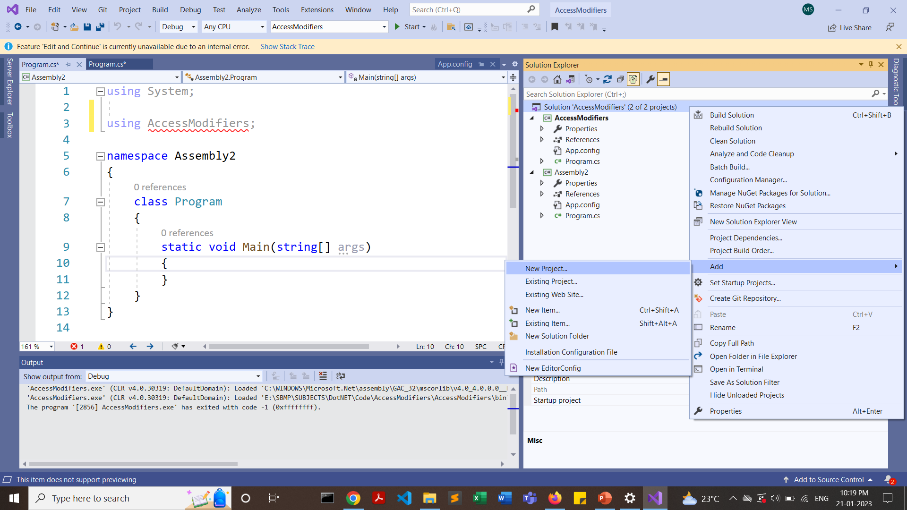
Right Click on Solution (As shown in the below diagram)

Slide 29
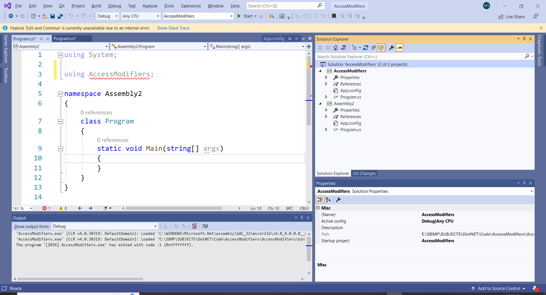
Select .NET Console Project, name=Assembly2

Slide 30
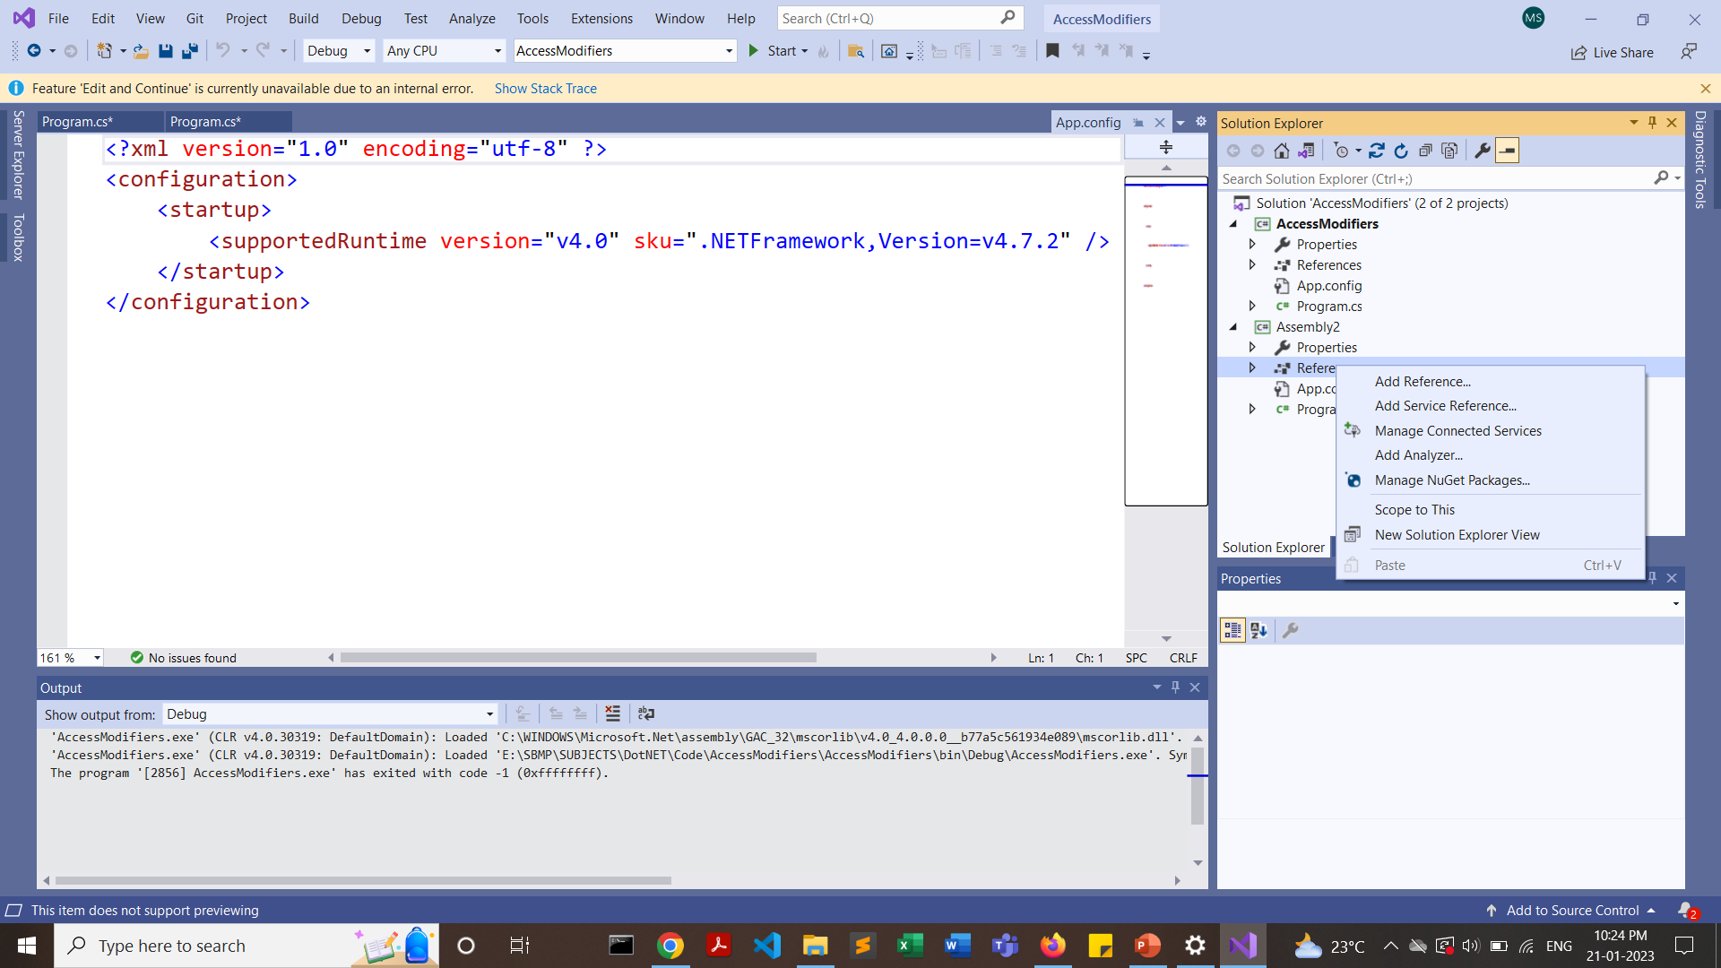
Add reference of namespace AccessModifiers to Assembly2 name space
Right Click Assembly2->References and click on Add References

Slide 31
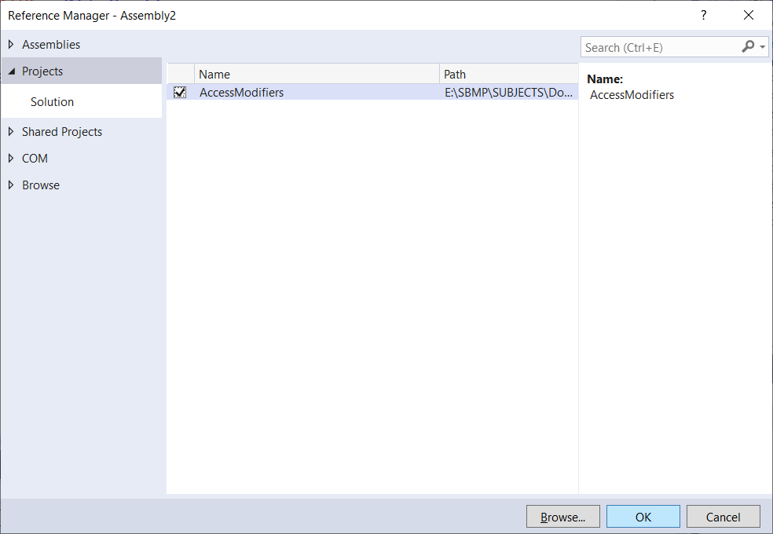
Add reference of namespace to Assembly2
Click on “Projects” tab at the left side and select the namespace “AccessModifiers” and press OK.

Slide 32
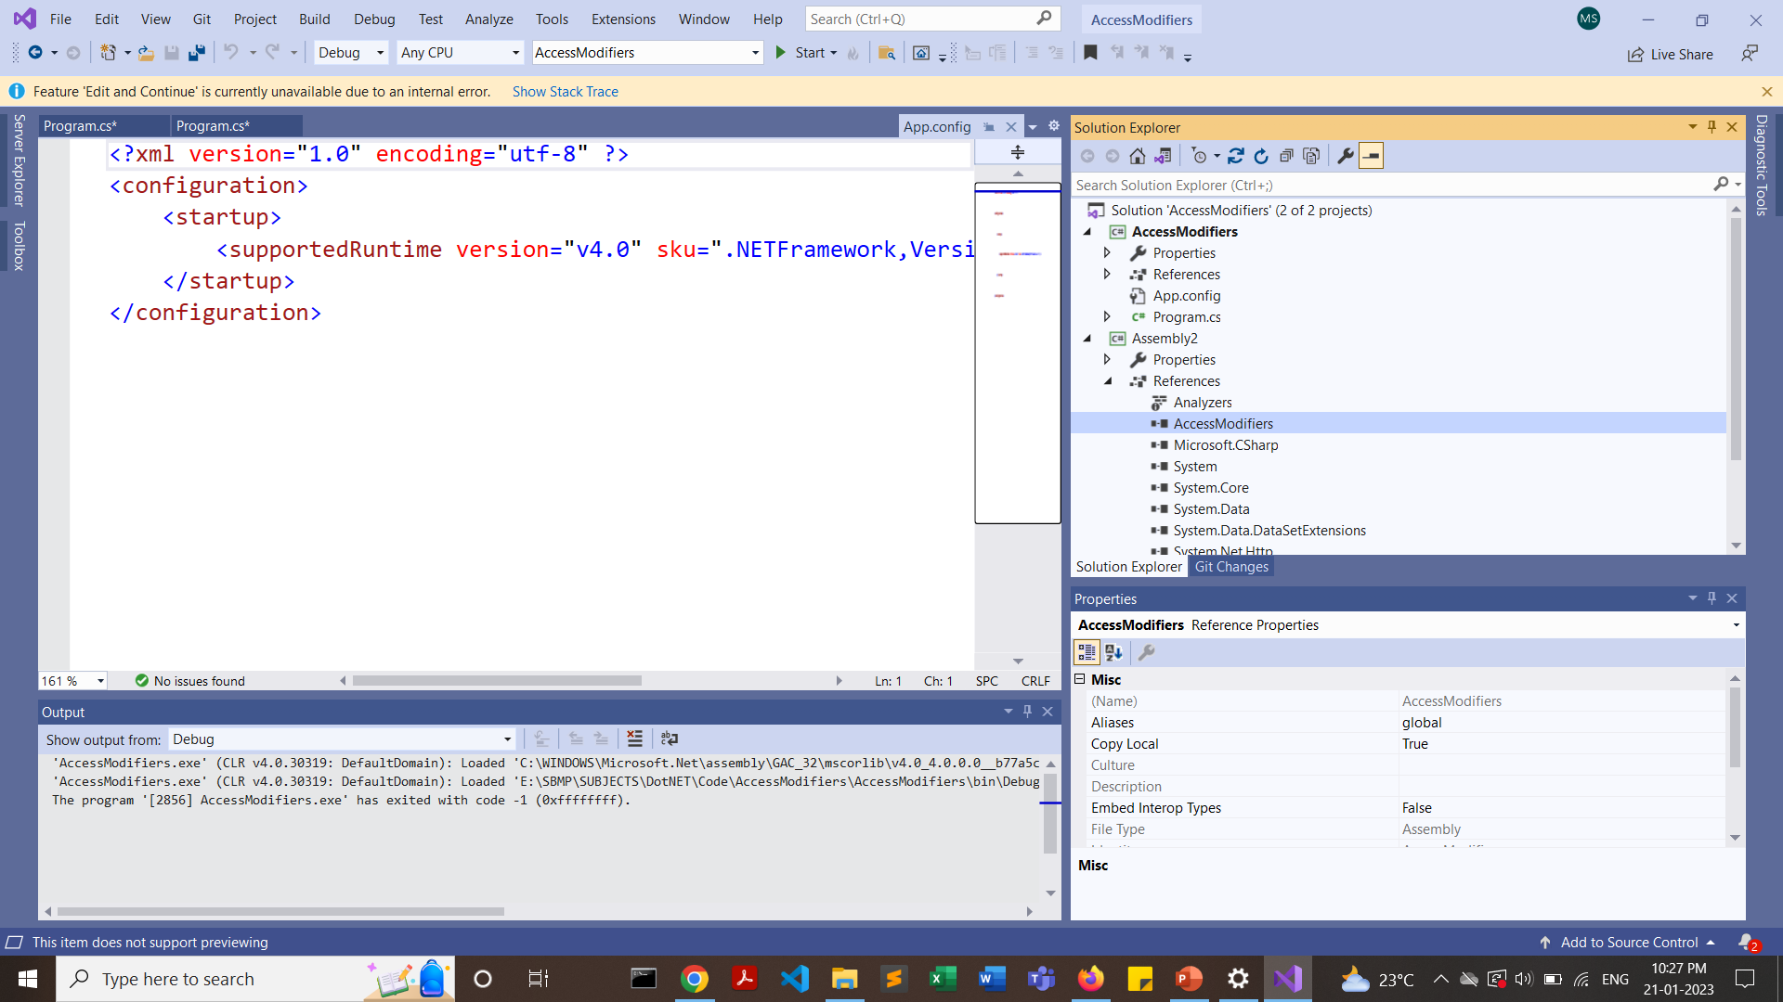
AccessModifiers is added now
Click on “Projects” tab at the left side and select the namespace “AccessModifiers” and press OK.

Slide 33
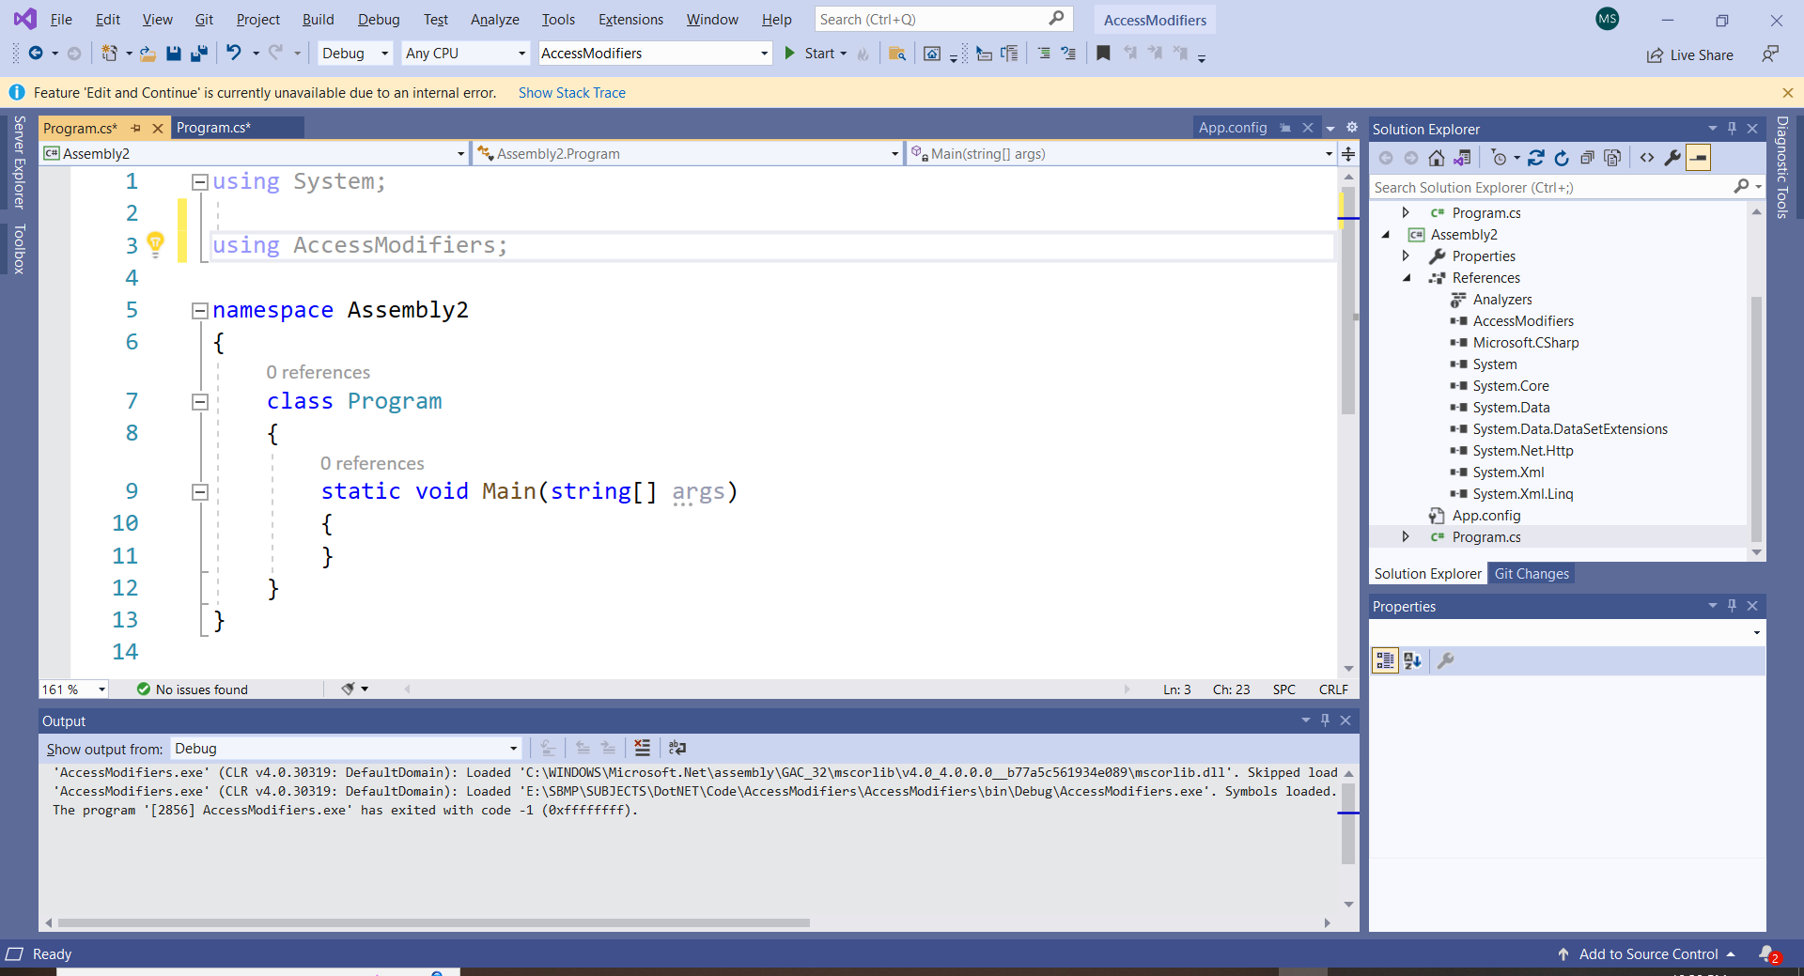
Write using AccessModifiers; as shown in the diagram.

Slide 34
Now, Create a class Demo1 inside, AccessModifiers name space and try to access its property from Assembly2 namespace
namespace AccessModifiers
{ public class Demo1
{
public int a;
}
// other code
}

Slide 35
Now, Create a class Demo1 inside, AccessModifiers name space and try to access its property from Assembly2 namespace
using System;
using AccessModifiers;
namespace Assembly2
{
class Program
{
static void Main(string[] args)
{
Demo1 ob1 = new Demo1();
Console.WriteLine(ob1.a);
Console.ReadKey();
}
}
0

Slide 36
Testing various access specifiers

Slide 37
Meaning of string? => can accept null input
https://stackoverflow.com/questions/121680/whats-the-difference-between-int-and-int-in-c

Slide 38
TEST CASE 1
1a) Declare Person class having name and age as data members (without specifiers). Provide constructor to take parameters.
Create another class “TestDemo” inside which Main() resides. Create an object of class Person with 2 parameters as arguments. Try to display name and age individually using the object i.e. p1
OBSERVE the code
1b) Declare name and age as public and observe the code
1c) Declare name as protected and observe the code
1d) Declare name as protected internal and observe the code

Slide 39
namespace AccessSpecifiers
{
class Person
{
// Declaring members rollNo
// and name as public
string name;
int age;
// Constructor
public Person(string n, int a)
{
name = n;
age = a;
}
// methods getRollNo and getName
// also declared as public
public int GetAge()
{
return age;
}
public string GetName()
{
return name;
}
}

Slide 40
class TestDemo
{
static void Main(string[] args)
{
Person p1 = new Person("MRS",25);
Console.WriteLine(p1.name);
Console.WriteLine(p1.age);
Console.ReadKey();
}
}

Slide 41
TEST CASE 1
1e) Declare name as a protected in Person. Derive a Student class from Person and try to access name inside any methods of Student class…. Observe the code

Slide 42
class Student : Person
{
// Declaring member rollNo
public int rollNo;
// Constructor
public Student(string n, int a, int r) : base(n, a)
{
rollNo = r;
name = n;
}
}

Slide 43
TEST CASE 2
Now declare name as internal
Create another assembly “Assembly2” Define a class named “OtherAssemblyTestDemo” and try to create an object of Person class.
Observe the code…

Slide 45
C# class library

Slide 46
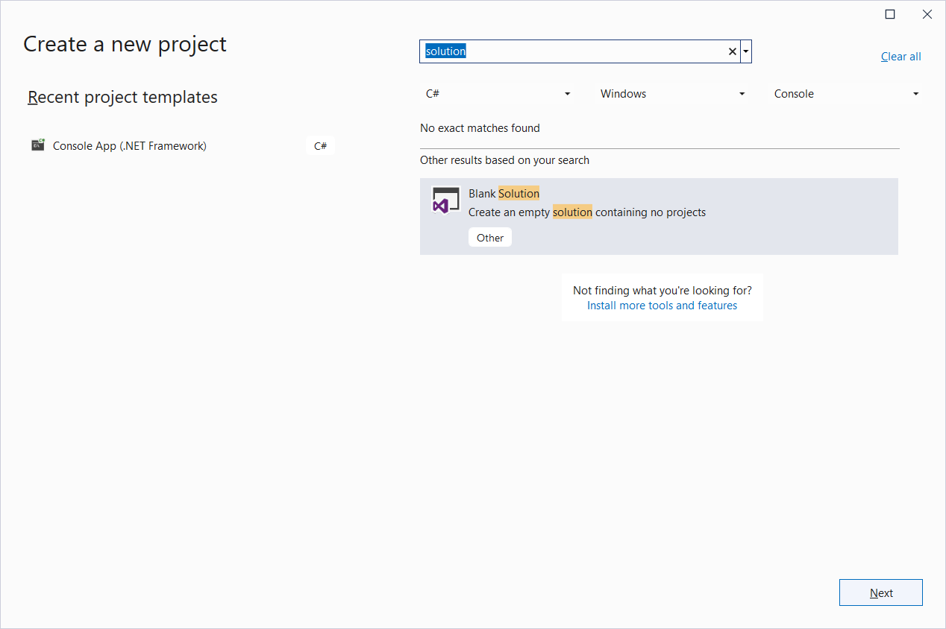
Select a “Blank Solution” in the project types

Slide 47
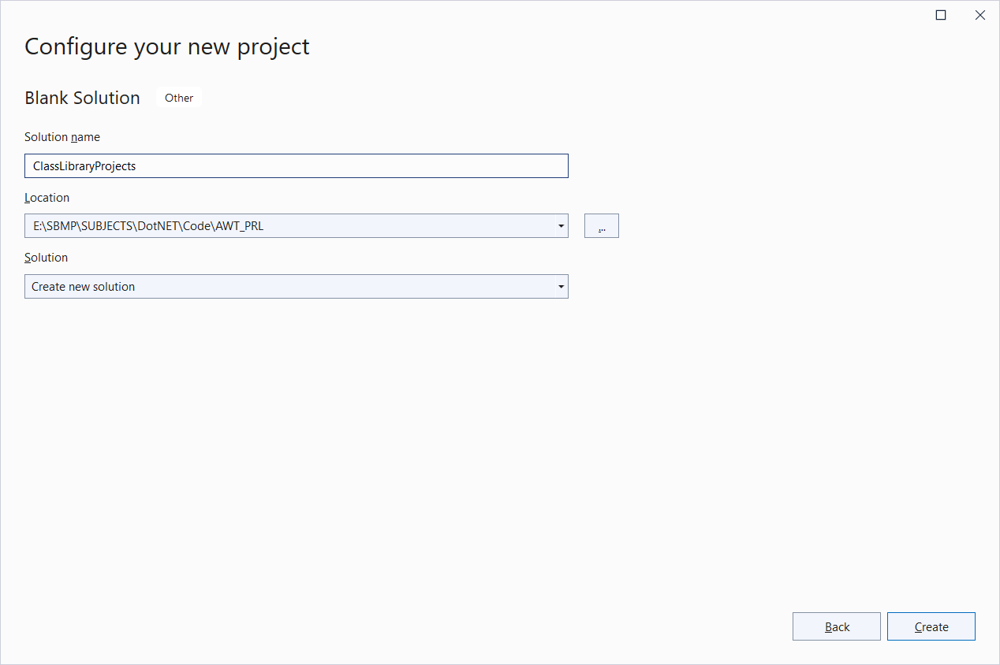

Slide 48
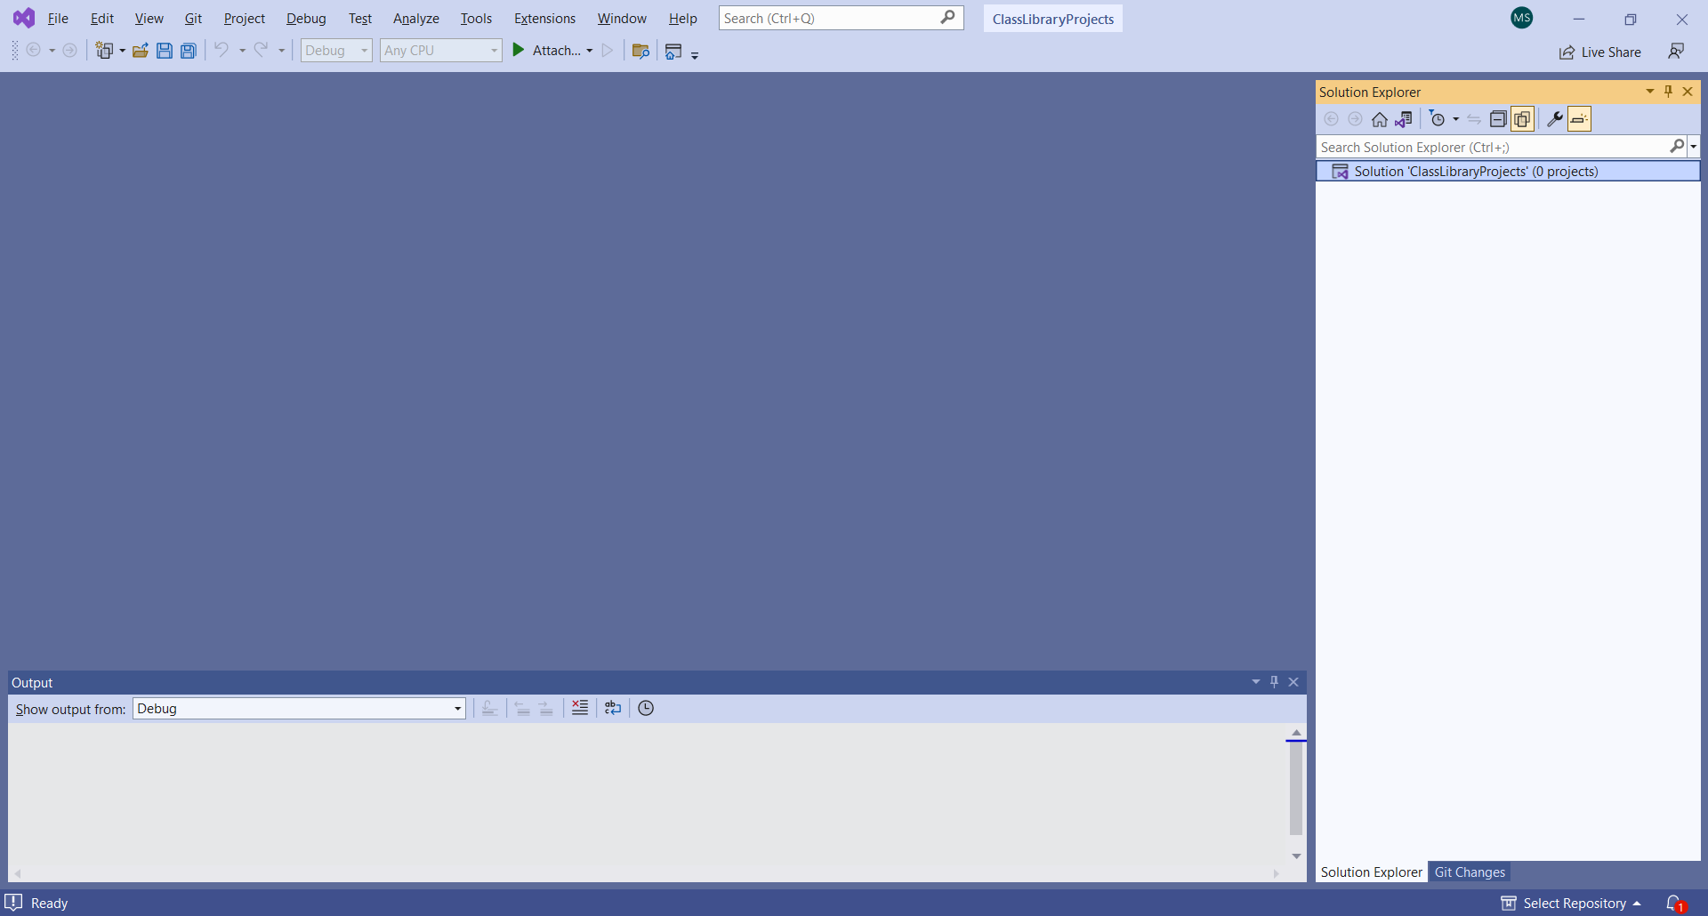

Slide 49
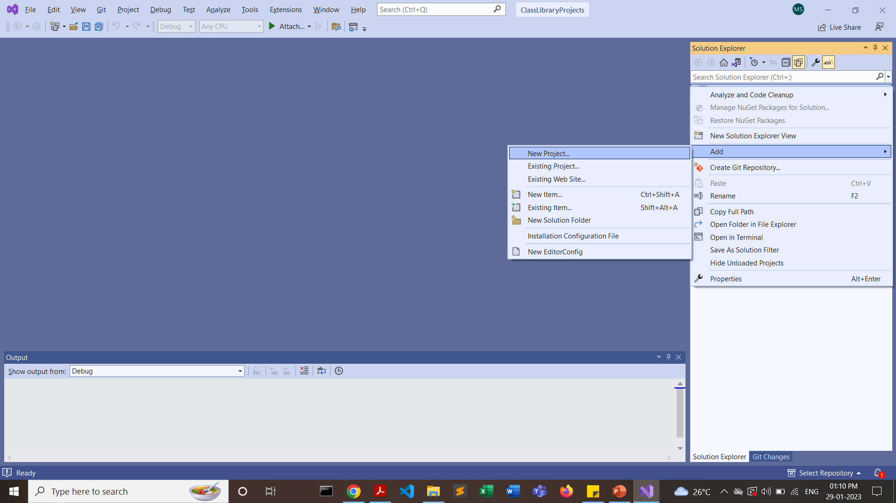

Slide 50
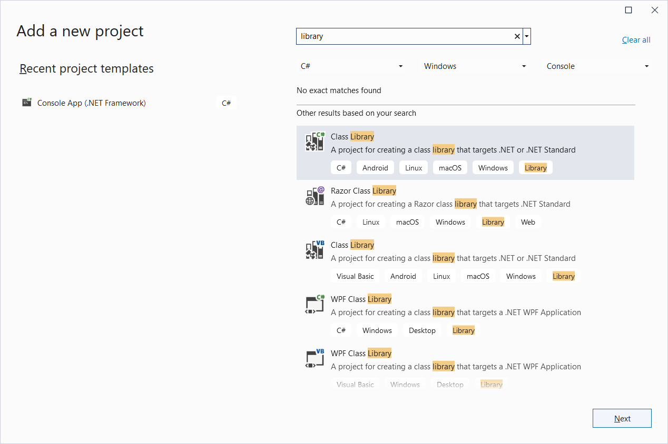
Search “library” in the search box and choose “Class Library”

Slide 51
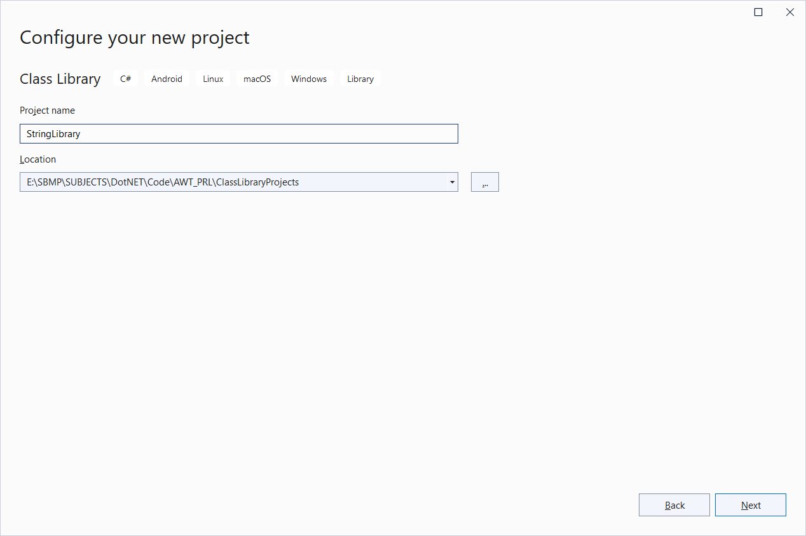
Give the name as “StringLibrary”

Slide 52
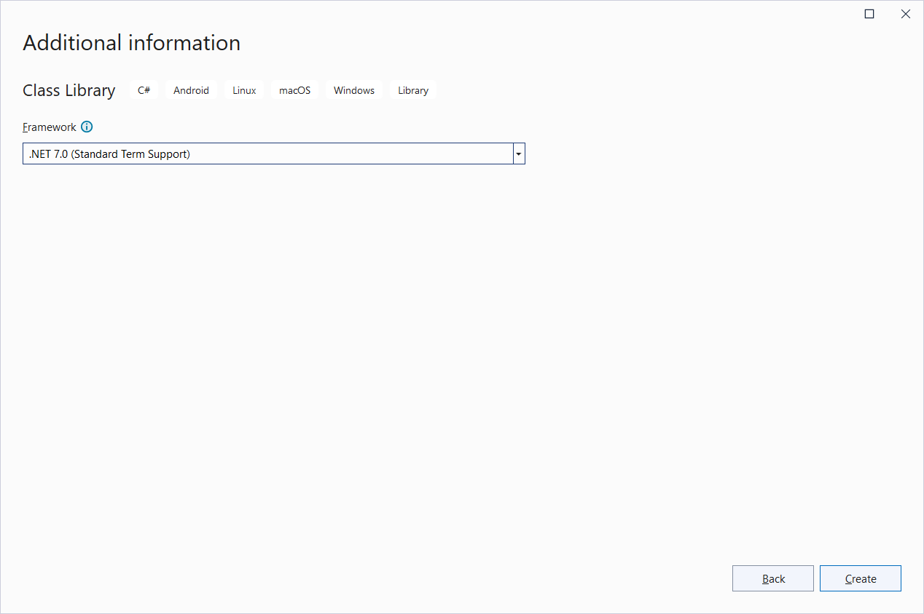
Select “.NET 7.0” and create

Slide 53
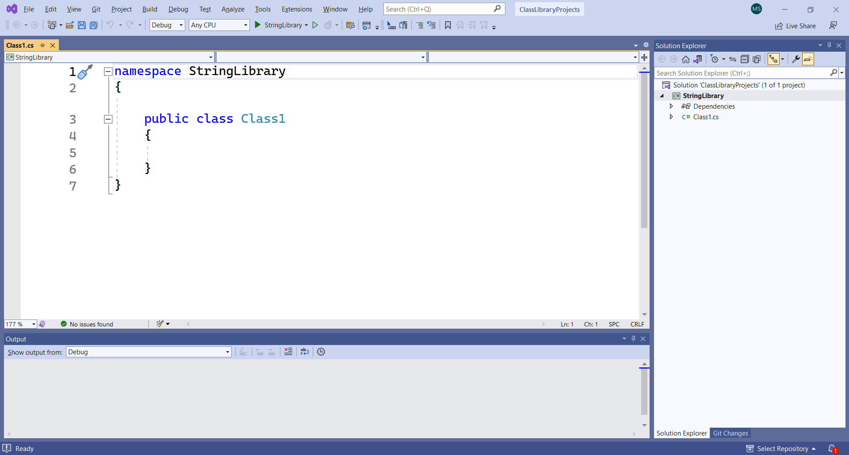

Slide 54
namespace UtilityLibraries;
public static class StringLibrary
{
public static bool StartsWithUpper(this string? str)
{
if (string.IsNullOrWhiteSpace(str))
return false;
char ch = str[0];
return char.IsUpper(ch);
}
}

Slide 55
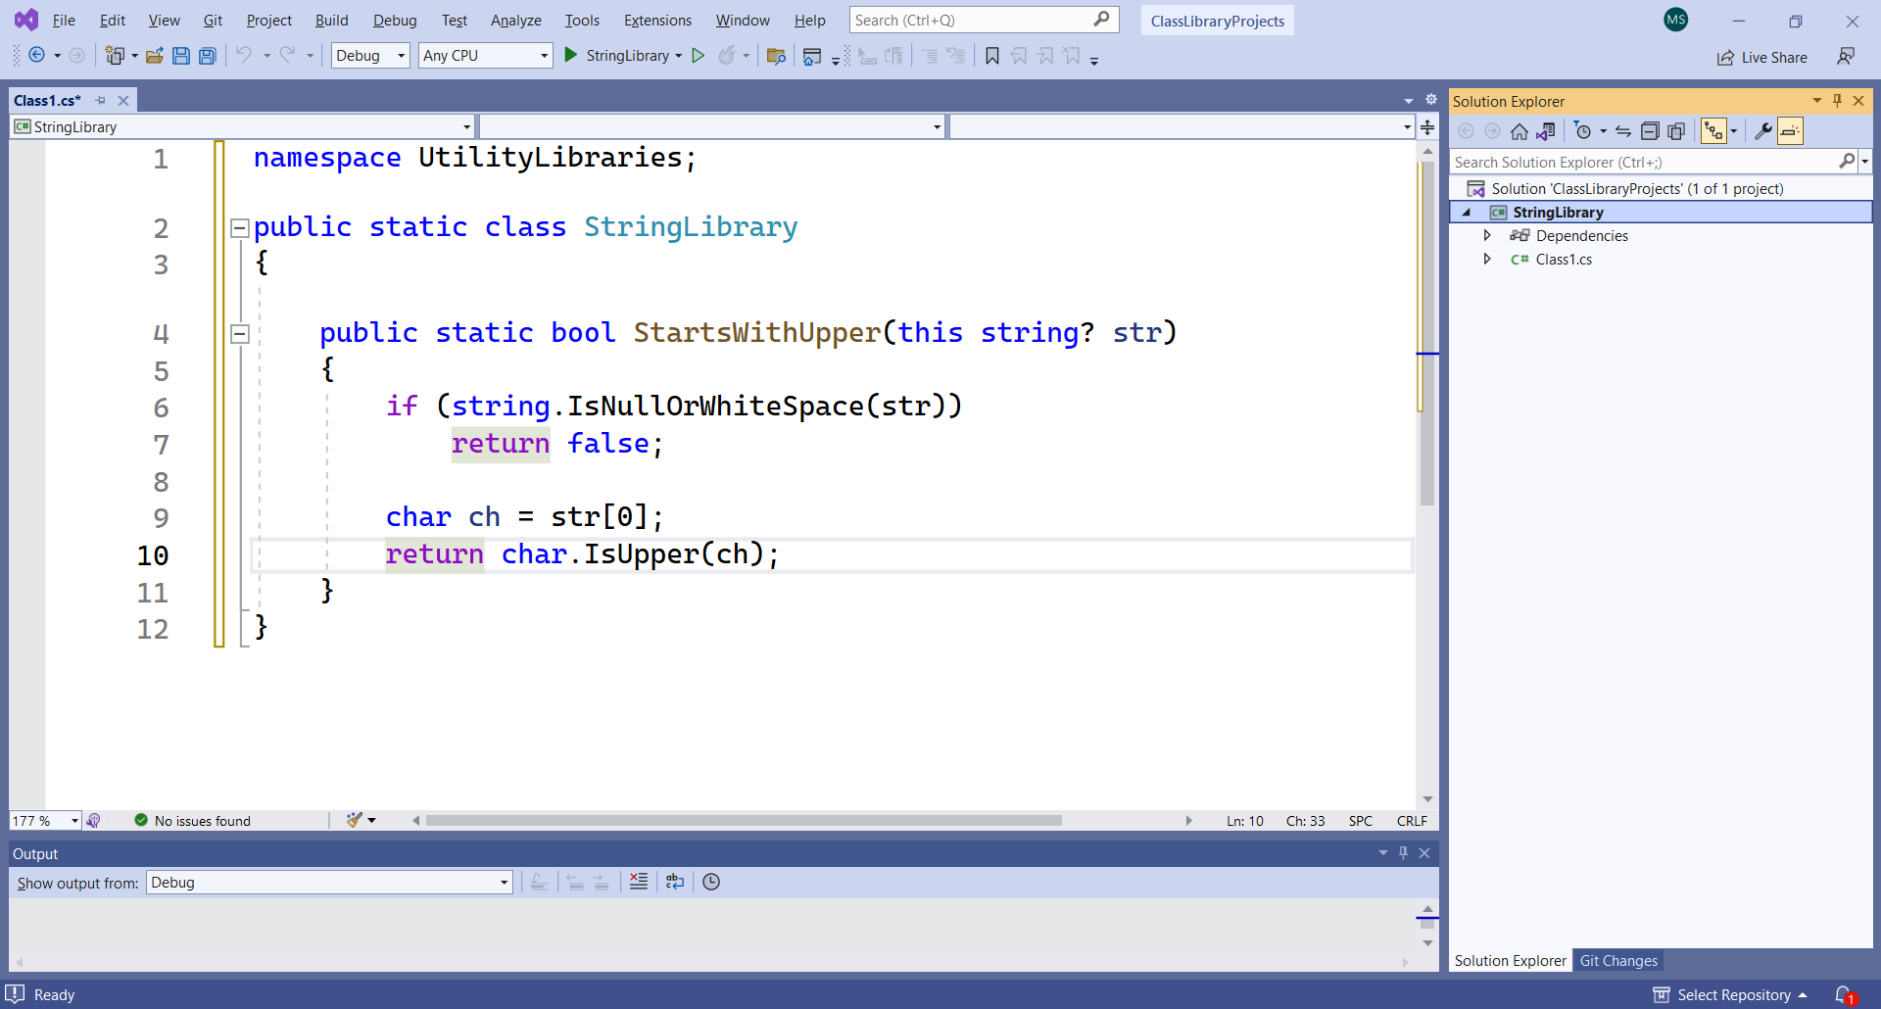
The class library, UtilityLibraries.StringLibrary, contains a method named StartsWithUpper. This method returns a Boolean value that indicates whether the current string instance begins with an uppercase character.

Slide 56
Add a console app to the solution
Add a console application that uses the class library. The app will prompt the user to enter a string and report whether the string begins with an uppercase character.
Add a new .NET console application named “TestLibrary" to the solution.
Right-click on the solution in Solution Explorer and select Add > New project.
On the Add a new project page, enter console in the search box. Choose C# or Visual Basic from the Language list, and then choose All platforms from the Platform list.
Choose the Console Application template, and then choose Next.
On the Configure your new project page, enter TestLibrary in the Project name box. Then choose Next.
On the Additional information page, select .NET 7 (Standard-term support) in the Framework box. Then choose Create.

Slide 57
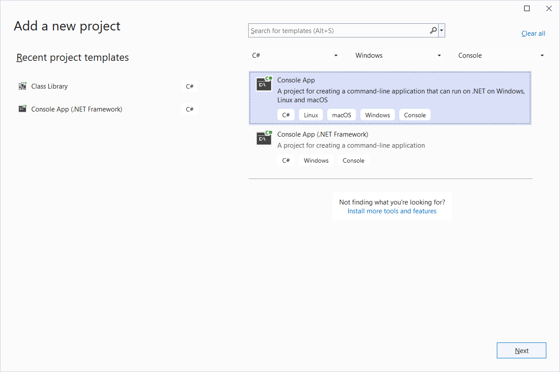

Slide 58


Slide 59
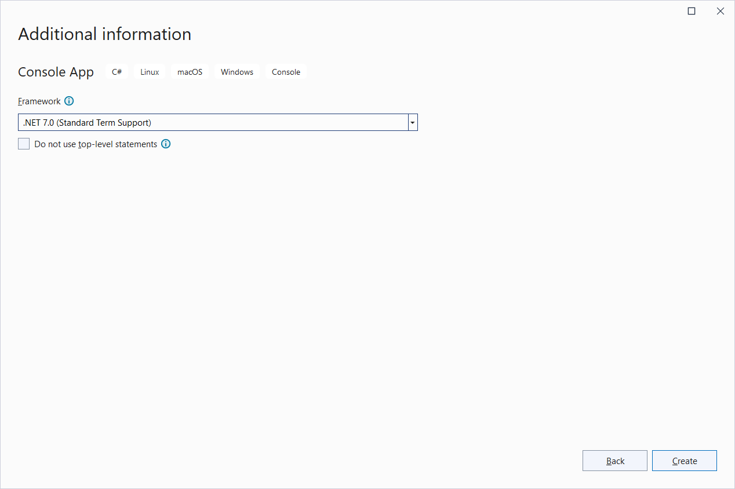

Slide 60
In the code window for the Program.cs, replace all of the code with the following code.
using UtilityLibraries;
class Program
{ static void Main(string[] args)
{
while (true)
{
Console.WriteLine("Enter the String.(empty/null to end)");
string? input = Console.ReadLine();
if (string.IsNullOrEmpty(input))
break;
Console.WriteLine($"Input: {input}");
Console.WriteLine("Begins with uppercase? " +
$"{(input.StartsWithUpper() ? "Yes" : "No")}");
Console.WriteLine();
}
}
}

Slide 61
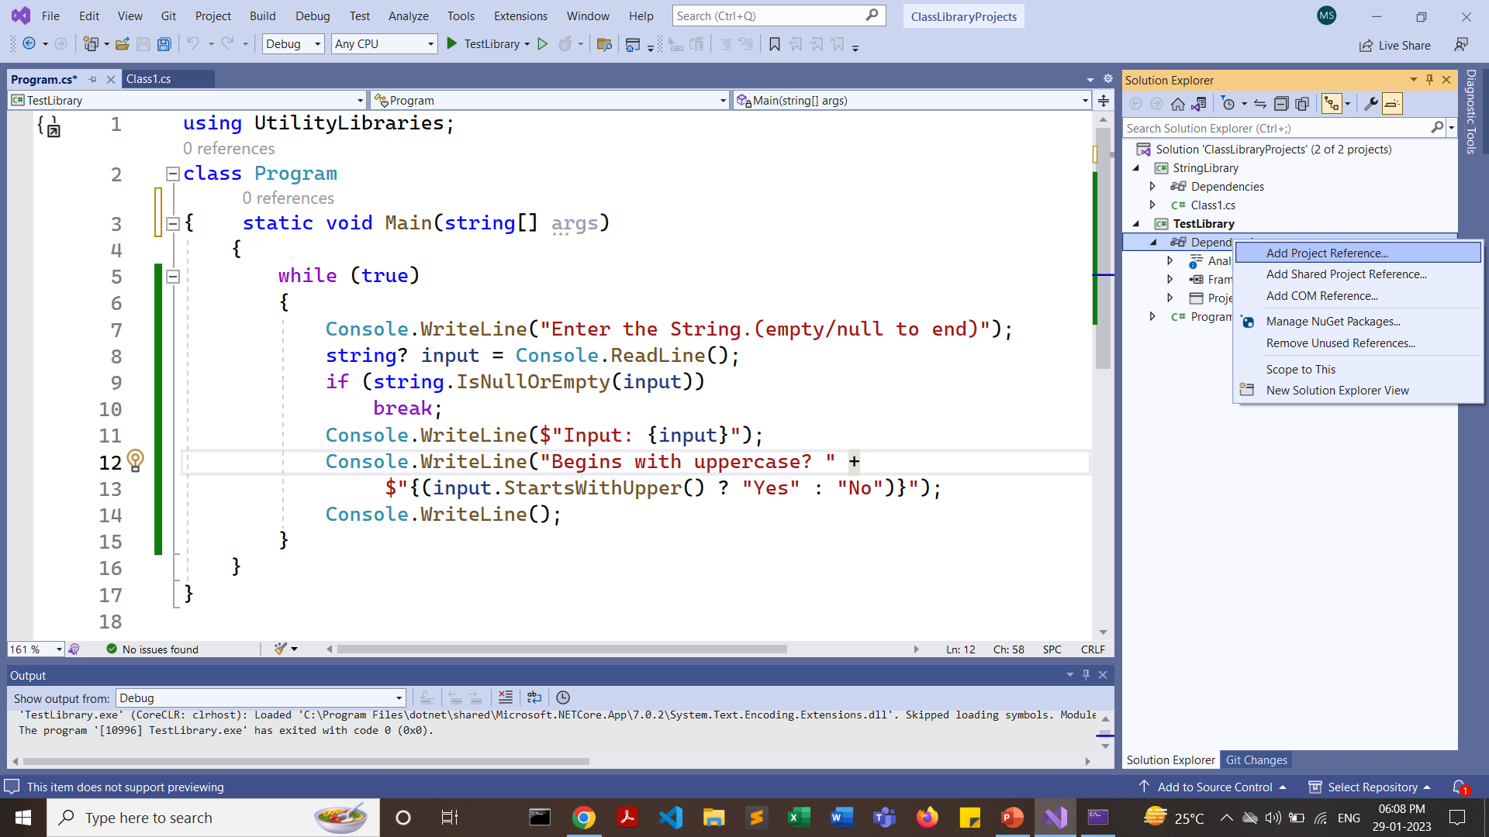
Add a project reference
In Solution Explorer, right-click the TestLibrary project's Dependencies node, and select Add Project Reference.

Slide 62
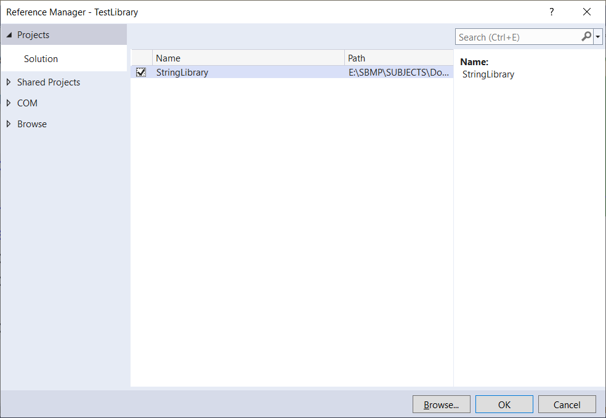
Check “StringLibrary”

Slide 63
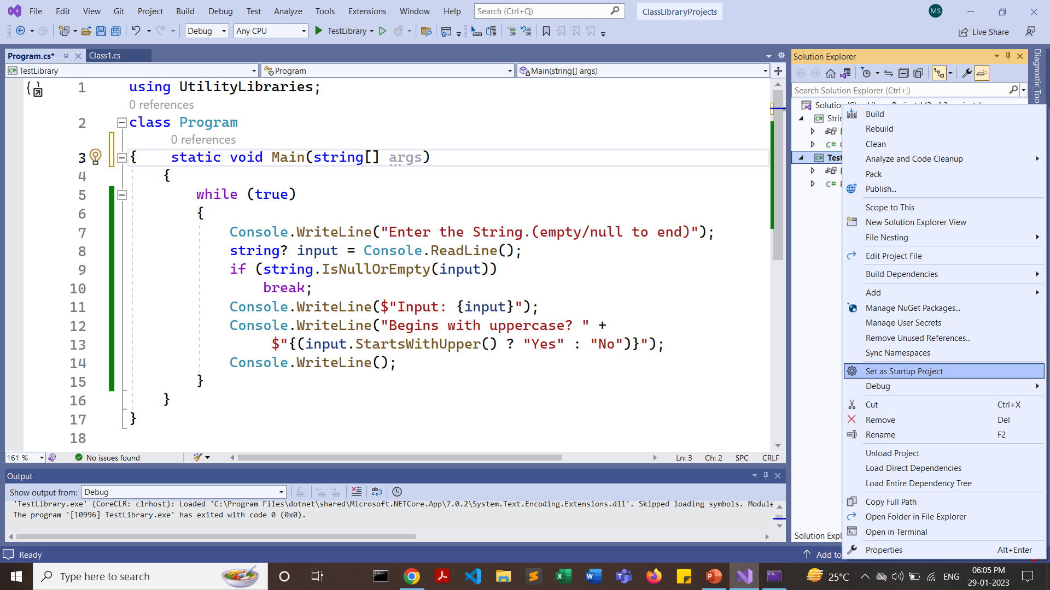
In Solution Explorer, right-click the TestLibrary project and select Set as StartUp Project in the context menu.

Slide 64
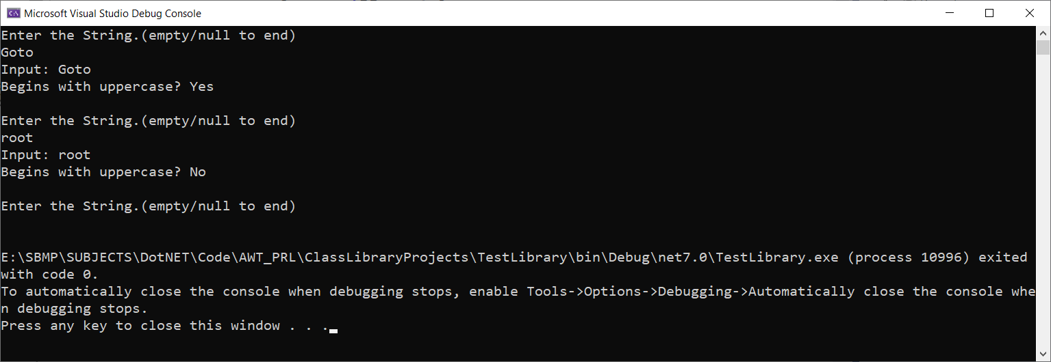
Press Ctrl+F5 to compile & run the project

Slide 65
Thanks!
Any questions?
You can find me at:
manish_ratilal2002@yahoo.com

Slide 66
Credits
https://www.geeksforgeeks.org/access-modifiers-in-c-sharp/
https://www.youtube.com/watch?v=sqcu19v7RcM&ab_channel=ScholarHatByDotNetTricks
https://learn.microsoft.com/en-us/dotnet/core/tutorials/library-with-visual-studio?pivots=dotnet-7-0

